Slide 1

King County Housing Price Prediction
Mini IronKaggle Project | Machine Learning Analysis for the Real Estate Market

Slide 2
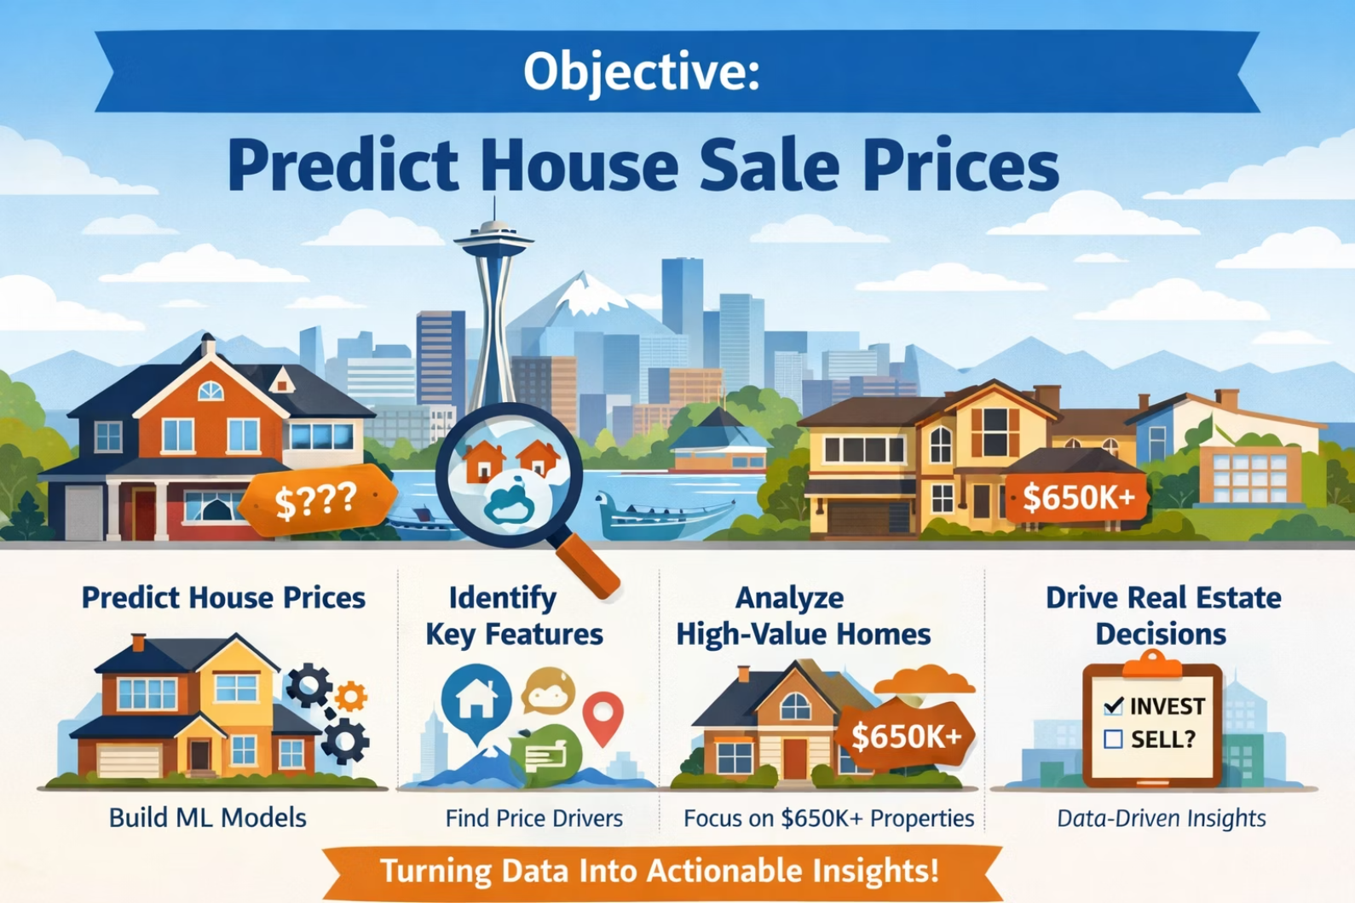
BUSINESS PROBLEM
Project Objectives
Predict Prices
Develop accurate predictive models for sale values
Identify Drivers
Determine the most influential characteristics on price
Premium Segment
Analyze properties above $650K
Informed Decisions
Support data-driven strategies in the real estate sector

Slide 3
DATASET
Data Overview
21
1
Features
Year
Structural, geographical, and qualitative variables
Transactions from 2014-2015
Location: King County, Washington
Target Variable: Sale price (continuous)
Feature Examples
Living area (sqft_living)
Quality rating (grade)
Geographical coordinates
Waterfront
Year of construction
Neighborhood metrics

Slide 4




Exploratory Analysis
Living Area
Grade
Location
Waterfront
Strongest correlation: sqft_living demonstrates a positive linear relationship with price
High grade indicates premium finishes and significantly impacts value
Latitude and longitude reveal geographic patterns of valuation
Properties with water access command a substantial premium
We observed non-linear patterns and the presence of outliers, suggesting that simple linear models may not capture the full complexity of the data.

Slide 5







MODELING
Machine Learning Approach
Models Tested
01
Linear Regression
Baseline for comparison
02
ADA
improve the accuracy of weak classifiers
03
KNN
Preparation
Baseline Models
Ensemble Models
Feature Engineering
Selection
Proximity-based approach
04
Structured pipeline from pre-processing to final validation
Random Forest
Ensemble of decision trees
05
Gradient Boosting
Optimized sequential model
Evaluation Metrics: R² (coefficient of determination) and MAE (mean absolute error)

Slide 6
Teamwork
Data Prep, Exploration, Cleaning
Baseline Models
KNN, Linear Regression
XGB
Random Forest
ADA
Gradient
pick best ensemble models
evaluate each test using a function
feature engineering

Slide 7
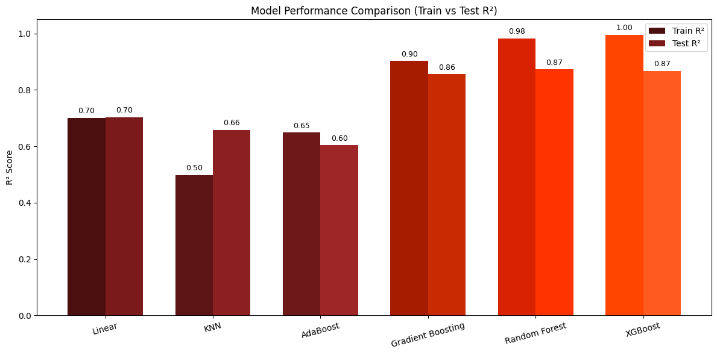

RESULTS
Model Performance before feature engineeering
✅ Best Model: XGB
R² = 0.99 | Low MAE
XGBoost and Random Forest performed the best out of all models tested.

Slide 8
Feature Engineering
Dropped Columns: Sqft_above + sqft_basement = sqft_living, so we can drop redundant sqft columns. Model performance was minimally better when dropping sqft_living”, but we still dropped sqft_above + sqft_basement. Why?
it removes 2 columns instead of 1
it’s likelier that real-life data is missing for the subcategories sqft_above and sqft_basement
Zipcode:
one-hot-encoded as a categorical value
Removed outliers (top/bottom % of sqft_living)
House Age: Calculated as “Date” - “Yr_Built”
Yr_Renovated: Turned Boolean (1 = Renovated, 0 = Not Renovated)
View: Turned (1 = Viewed, 0 = Not Viewed)

Slide 9
Best Model after Feature Engineering
XGBoost with GridSearchCV
Feature Engineering: as mentioned on previous slide
Best Parameters: {'learning_rate': 0.1, 'max_depth': 7, 'n_estimators': 300}
=== Model Evaluation ===
train_r2: 0.9570
test_r2: 0.9071
train_mse: 4300432392.8546
test_mse: 9067113808.9792
train_rmse: 65577.6821
test_rmse: 95221.3937
train_mae: 45672.8331
test_mae: 59339.3464
Q: Can we drop further columns to simplify the model?
A: Probably. We started testing, but so far our tests led to worse model performance.

Slide 10
Next Steps
Further test how dropping columns impacts results
Test if model stability remains if we drop more less relevant columns
Cross-validate results

Slide 11

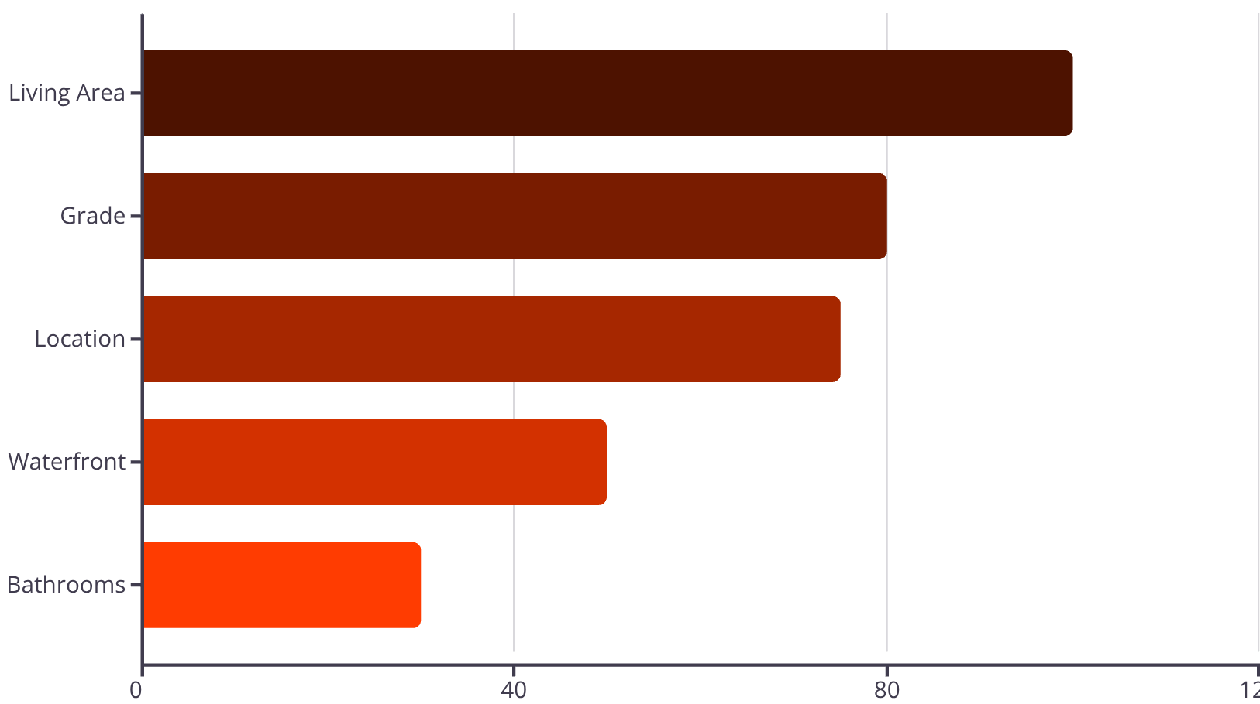
Importance of Features
PRICE DRIVERS
Top 5 Most Influential Features
1
Living Area (sqft_living)
Dominant predictor of market value
2
Grade
Construction quality and finishes
3
Location (lat/long)
Geographic coordinates reveal location premium
4
Waterfront
Water access as a premium differentiator
5
Bathrooms
Indicator of comfort and size
The model confirms that living area and quality grade dominate price determination. Location remains one of the strongest hidden drivers.

Slide 12



CONCLUSIONS
Key Learnings
Critical Pre-processing
Ensemble Superiority
Location + Size
Ensemble models consistently outperform linear approaches in complex real estate data
Two factors dominate real estate price formation
Adequate data treatment is fundamental for model performance
This project demonstrates how structured machine learning pipelines generate actionable insights from real estate data, balancing business interpretation and predictive accuracy.

Slide 13




High-Value Property Analysis
Property Characteristics > $650K
Larger Areas
Living space substantially above market average
Premium Finishes
Premium finishes and superior quality building materials
Prime Locations
Clustering in high-value geographical zones
Waterfront
Significantly higher prevalence of direct water access
The luxury segment shows distinct clustering around prime location and size. The presence of waterfront access substantially increases value in this segment.

Slide 14
From Data → Insights → Prediction
This project illustrates how machine learning can support real estate pricing decisions through structured data analysis and robust modeling techniques.
Thank you
Questions?

